Slide 1
CA1 Individual DAVI By: Loh Yip Khai

Slide 2
Title: Analysis of Housing Factors on Resident Population
Objective 1: Visualizing the general trend of Resident Population over the years
Objective 2: Finding out how the distribution of 3 housing factors affects the Resident Population

Slide 3
Objective: Visualizing the general trend of Resident Population over the years
The primary goal of this analysis is to understand how the resident population in various planning areas and subzones has changed over time.
By visualizing these trends, we can identify patterns and shifts in population distribution, which can inform urban planning and policy decisions.

Slide 4
Objective: How housing factors affect Resident Population
Housing Factors: Age Group (AG): Analyzing different age demographics helps in understanding the needs of various age segments, from young children to the elderly.
Floor Area (FA): The size of the residence could indicate socioeconomic status and influence population density and growth patterns.
Sex (Gender): Studying population distribution by sex helps in identifying gender-specific trends and needs in different areas.

Slide 5
Dataset Information
Column Headers:
PA - Planning Area
SZ - Subzone
AG - Age Group
Sex - Gender
FA - Floor Area of Residence
Pop - Resident Count
Time - Time / Period
Some outliers include some of the PA like Marine Centre, Clifford Pier have no data available, likely due to sample size being too small

Slide 6
Insights gained from analysis of data
Insights
Generally, both Gender (male and female) are equally distributed for each location
In the central area(Bishan, Ang Mo Kio, Yio Chu Kang), the Floor Area of Residence is about is mostly in the upper range of >100 to 120 and >120, suggest these people are more well-off
Generally, age group does not vary too much, where majority of people are middle aged(30-60 years)
Generally, population trend seems to decline year-on-year, there seems to be a slow decreasing trend of population from 2011 to 2020
However, some exceptions like Bukit Timah, Choa Chu Kang, Newton all have a slow upward increase instead

Slide 7
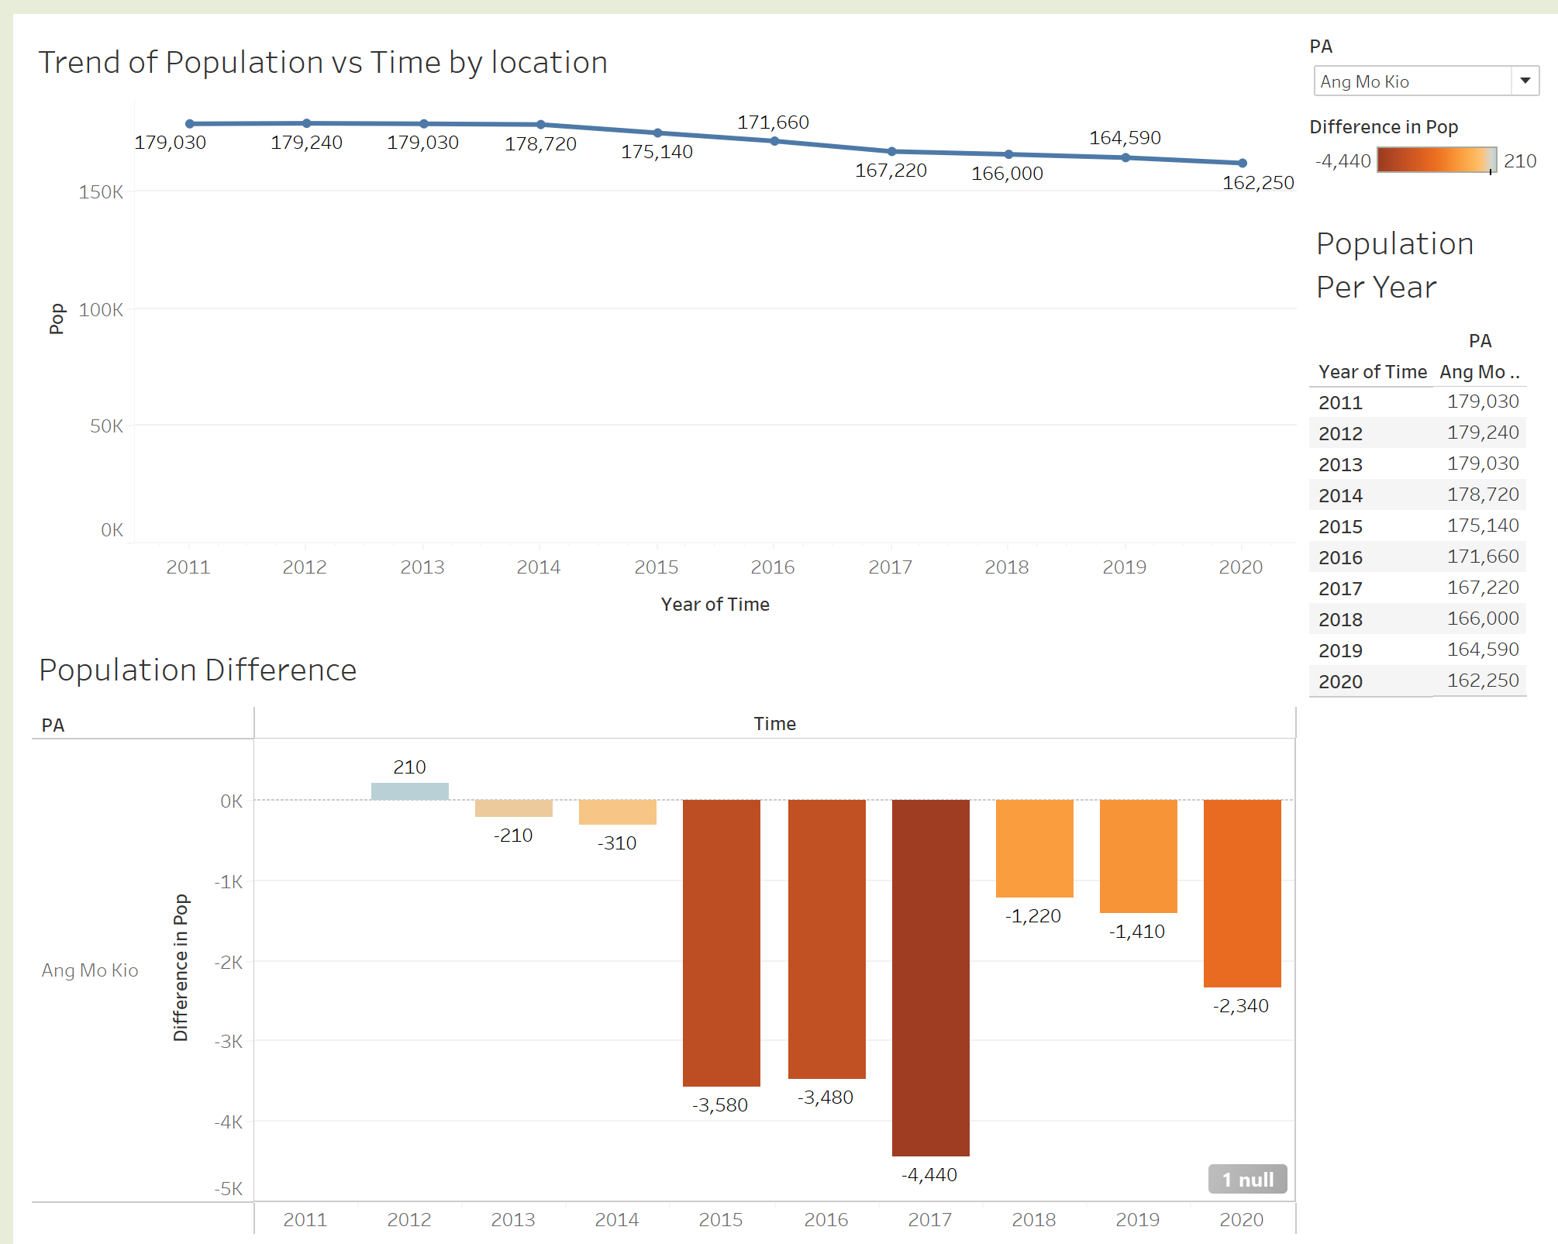
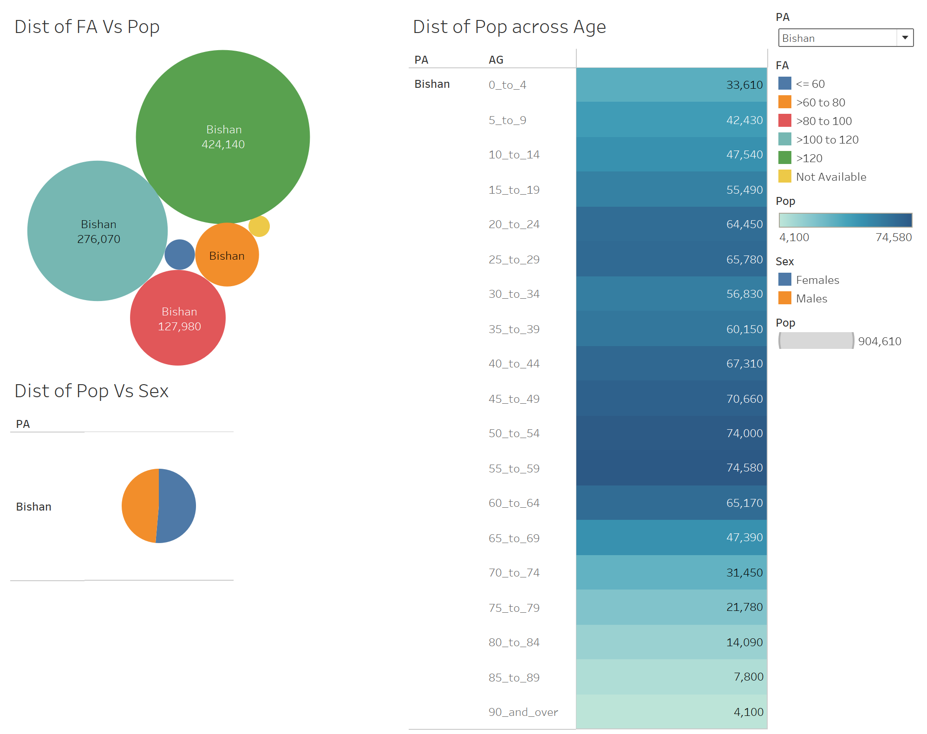
Example of Dashboard(Bishan)

Slide 8
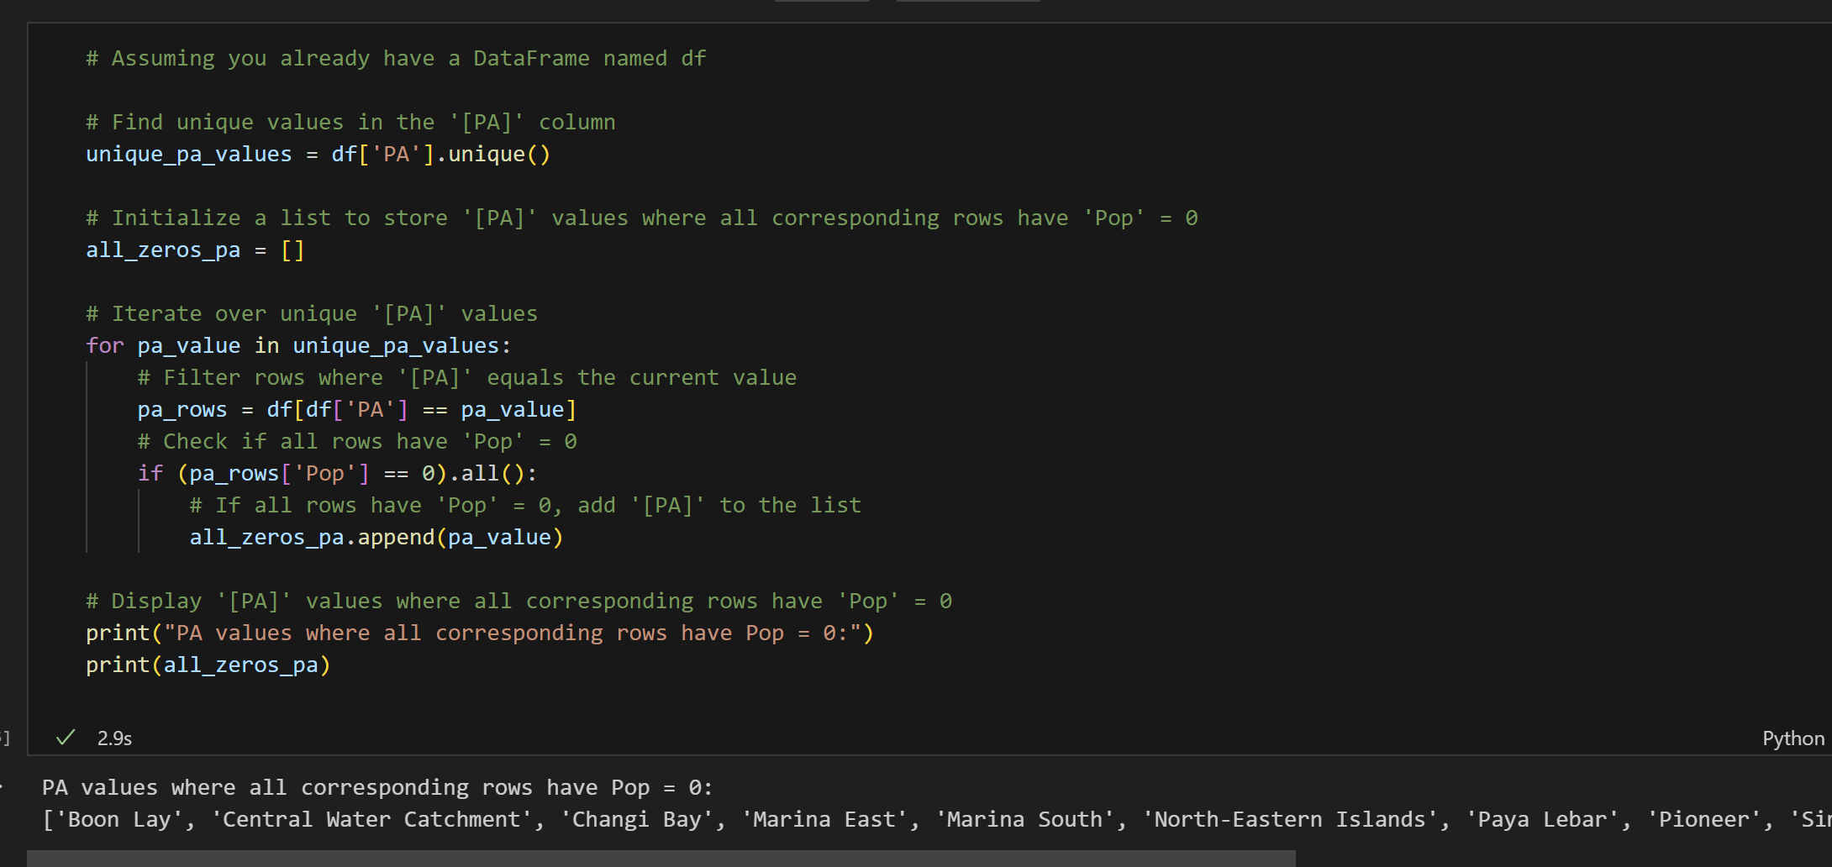
Data Wrangling
I loaded my dataset into a data frame
and checked for duplicate values and rows.
I found out that there were rows where
the location and population =0,
that were areas like Central
Water Catchment Area, and Changi
Bay.

Slide 9
Suggestion for Housing Improvement
Address Population Decline: Incentivize Young Families: Develop affordable housing schemes and family-friendly amenities to attract younger families to areas experiencing population decline.
Senior-Friendly Housing: Given the significant middle-aged population, consider developing more senior-friendly housing and services to retain and support an aging population.

Slide 10
URL(Dataset)
https://www.singstat.gov.sg/find-data/search-by-theme/population/geographic-distribution/latest-data

